Slide 1






Foundations of
Quantum Information Science (QIS 101)
Dave Biersach
Brookhaven National Laboratory
dbiersach@bnl.gov
Session 14
Linear Algebra

Slide 2
Session 14 – Goals
Review real and complex vectors, including addition, scalar multiplication, and dot product
Review real and complex matrices, including matrix inversion, transpose, adjoint, and inner product
Identify and use diagonal, symmetric, Identity, Hermitian, and Unitary matrices
Understand basis sets, transition matrices, and the Hadamard matrix
Appreciate the eigenvectors and eigenvalues of a matrix

Slide 3
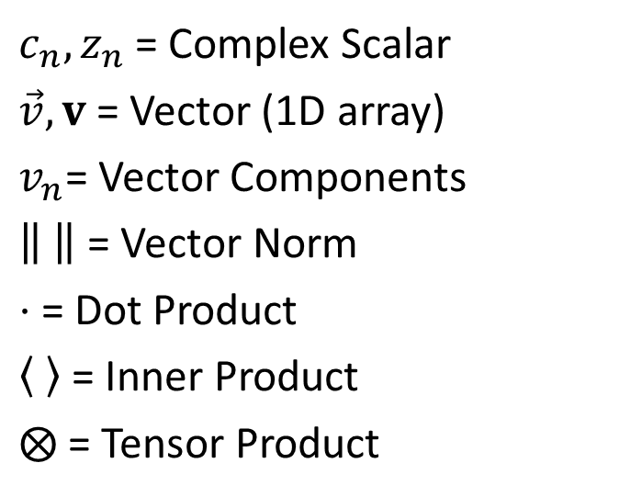
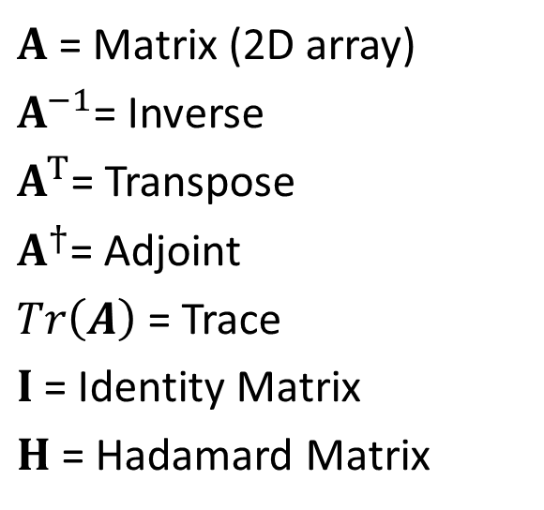
Symbols and Operators
$c_{n},z_{n}$ = Complex Scalar
$\vec{v}, v$ = Vector (1D array)
$v_{n}$= Vector Components
= Vector Norm
$⋅$ = Dot Product
= Inner Product
$⨂$ = Tensor Product
$A$ = Matrix (2D array)
$A^{−1}$= Inverse
$A^{T}$= Transpose
$A^{†}$= Adjoint
$Tr\left(A\right)$ = Trace
$I$ = Identity Matrix
$H$ = Hadamard Matrix

Slide 4
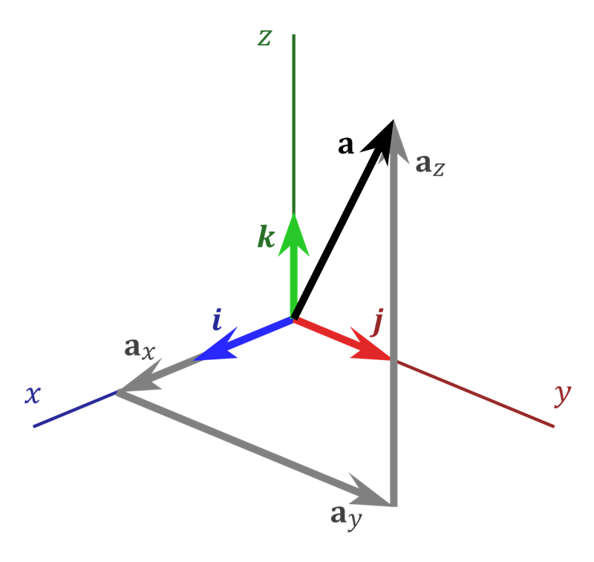

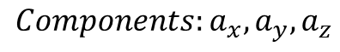
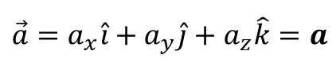
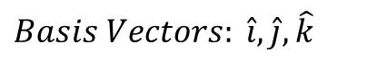

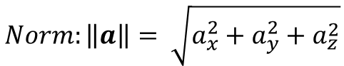
Real Vectors
$$Basis Vectors: \hat{i},\hat{j},\hat{k}$$
Unit Vectors
$$Components:a_{x},a_{y},a_{z}$$
How much of each basis makes up $\vec{a}$
$$\vec{a}=a_{x}\hat{i}+a_{y}\hat{j}+a_{z}\hat{k}=a$$
Vectors are basis independent,
components are not
$$Norm:\left\|a\right\|= \sqrt{a_{x}^{2}+a_{y}^{2}+a_{z}^{2}}$$
In basis $\hat{i},\hat{j},\hat{k}$

Slide 5
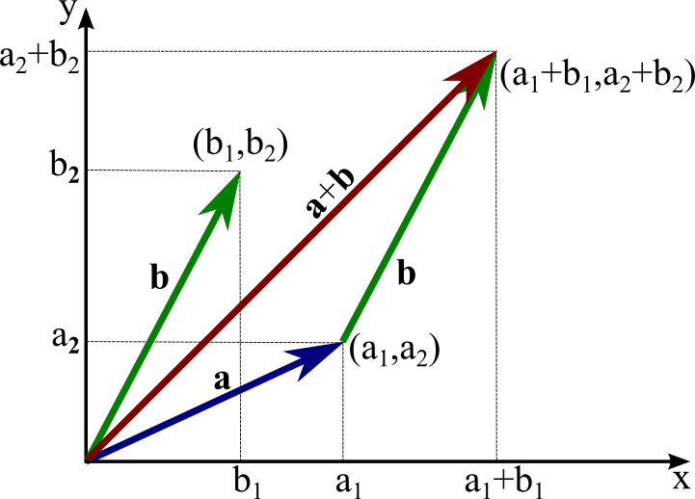
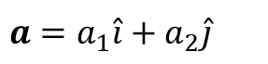
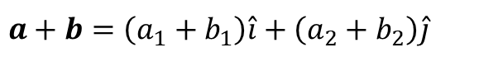
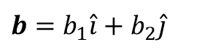
Real Vectors – Addition (Vector + Vector)
$$a=a_{1}\hat{i}+a_{2}\hat{j}$$
$$b=b_{1}\hat{i}+b_{2}\hat{j}$$
$$a+b=\left(a_{1}+b_{1}\right)\hat{i}+\left(a_{2}+b_{2}\right)\hat{j}$$

Slide 6
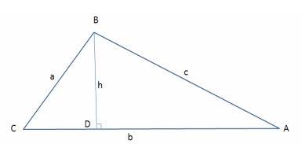


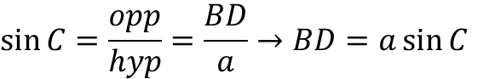
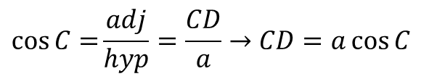

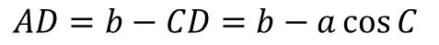
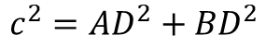

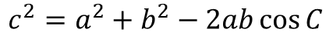
Real Vectors – Dot Product (Vector $⋅$Vector)
In $Δ BCD$:
$$\cos{C=}\frac{adj}{hyp}=\frac{CD}{a}→CD=a\cos{C}$$
$$\sin{C}=\frac{opp}{hyp}=\frac{BD}{a}→BD=a\sin{C}$$
In $Δ ABC$:
$$AD=b−CD=b−a\cos{C}$$
In $Δ ABD$:
Law of Cosines
$$c^{2}={AD}^{2}+{BD}^{2}$$
The square of a side of a triangle equals the sum of the squares of the remaining sides minus twice the product of those sides and the cosine of the angle between them
$$c^{2}={\left(b−a\cos{C}\right)}^{2}+{\left(a\sin{C}\right)}^{2}$$
$$c^{2}=a^{2}\left(\sin^{2}{C}+\cos^{2}{C}\right)+b^{2}−2ab\cos{C}$$
$$c^{2}=a^{2}+b^{2}−2ab\cos{C}$$

Slide 7
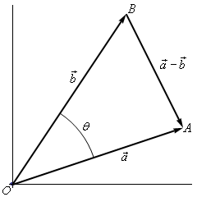
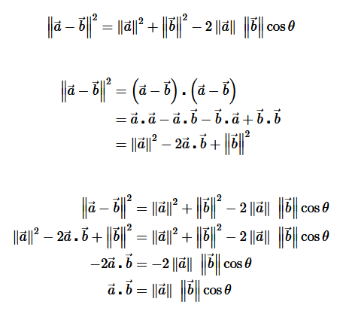
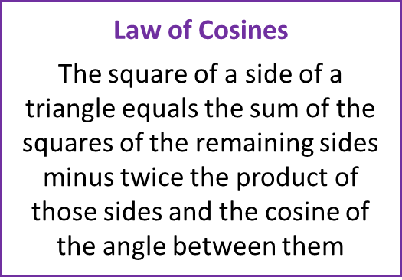
Real Vectors – Dot Product (Vector $⋅$Vector)

Slide 8
Real Vectors – Dot Product (Vector $⋅$Vector)

Slide 9
Real Vectors – Dot Product (Vector $⋅$Vector)

Slide 10
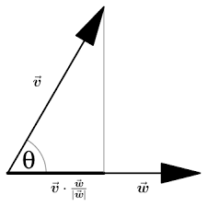
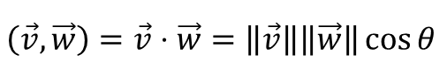

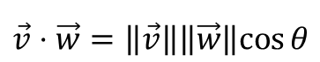

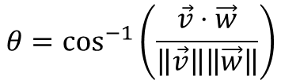
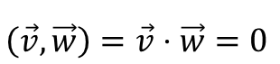
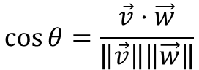
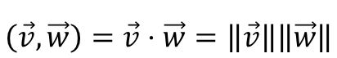
Real Vectors – Dot Product (Vector $⋅$Vector)
$$\vec{v}⋅\vec{w}=\left\|\vec{v}\right\|\left\|\vec{w}\right\|cos{θ}$$
$$\cos{θ}=\frac{\vec{v}⋅\vec{w}}{\left\|\vec{v}\right\|\left\|\vec{w}\right\|}$$
$$θ=\cos^{−1}\left(\frac{\vec{v}⋅\vec{w}}{\left\|\vec{v}\right\|\left\|\vec{w}\right\|}\right)$$
$$\left(\vec{v},\vec{w}\right)=\vec{v}⋅\vec{w}=\left\|\vec{v}\right\|\left\|\vec{w}\right\|\cos{θ}$$
← Dot product (Euclidean)
$$\left(\vec{v},\vec{w}\right)=\vec{v}⋅\vec{w}=\left\|\vec{v}\right\|\left\|\vec{w}\right\|$$
← If parallel $\left(θ=0\right)$
$$\left(\vec{v},\vec{w}\right)=\vec{v}⋅\vec{w}=0$$
← If perpendicular $\left(θ=\frac{π}{2}\right)$

Slide 11

Real Vectors – Dot Product (Vector $⋅$Vector)
For generalized
real vectors
(not necessarily Euclidean 2D)
$$\left(v,w\right)=v⋅w=v_{1}w_{1}+v_{2}w_{2}{+v}_{n}w_{n}$$
← Inner product (produces a scalar)
$$\left(v,v\right)=v⋅v=v_{1}v_{1}+v_{2}v_{2}{+v}_{n}v_{n}={\left\|v\right\|}^{2}$$
$$\left\|v\right\|=\sqrt{v⋅v}$$
The norm of a real vector is the square root of its own inner product

Slide 12

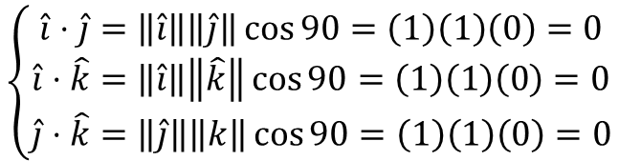
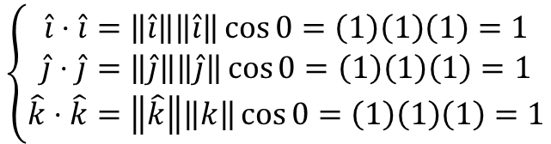
Real Vectors – Dot Product (Vector $⋅$Vector)
Each of these unit vectors lies entirely along itself
$$\left\{\begin{matrix}\hat{i}⋅\hat{i}=\left\|\hat{i}\right\|\left\|\hat{i}\right\|\cos{0}=\left(1\right)\left(1\right)\left(1\right)=1 \\ \hat{j}⋅\hat{j}=\left\|\hat{j}\right\|\left\|\hat{j}\right\|\cos{0}=\left(1\right)\left(1\right)\left(1\right)=1 \\ \hat{k}⋅\hat{k}=\left\|\hat{k}\right\|\left\|k\right\|\cos{0}=\left(1\right)\left(1\right)\left(1\right)=1\end{matrix}\right.$$
$$\left\{\begin{matrix}\hat{i}⋅\hat{j}=\left\|\hat{i}\right\|\left\|\hat{j}\right\|\cos{90}=\left(1\right)\left(1\right)\left(0\right)=0 \\ \hat{i}⋅\hat{k}=\left\|\hat{i}\right\|\left\|\hat{k}\right\|\cos{90}=\left(1\right)\left(1\right)\left(0\right)=0 \\ \hat{j}⋅\hat{k}=\left\|\hat{j}\right\|\left\|k\right\|\cos{90}=\left(1\right)\left(1\right)\left(0\right)=0\end{matrix}\right.$$
No part of these unit vectors lies along any other
$\hat{i},\hat{j},\hat{k}$ are the canonical orthonormal basis vectors in $ℝ^{3}$

Slide 13
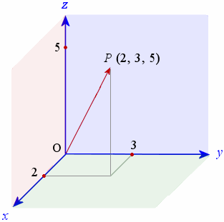

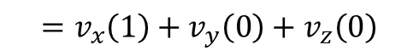

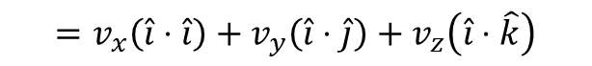

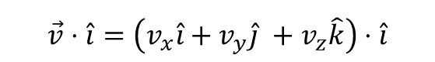


Real Vectors – Dot Product (Vector $⋅$Vector)
$$\vec{v}⋅\hat{i}=\left(v_{x}\hat{i}+v_{y}\hat{j} +v_{z}\hat{k}\right)⋅\hat{i}$$
$$=v_{x}\left(\hat{i}⋅\hat{i}\right)+v_{y}\left(\hat{i}⋅\hat{j}\right)+v_{z}\left(\hat{i}⋅\hat{k}\right)$$
$$\vec{v}$$
$$=v_{x}\left(1\right)+v_{y}\left(0\right)+v_{z}\left(0\right)$$
$$=v_{x}$$
$$\vec{v}⋅\hat{i}=v_{x}$$
We can get the individual components of a real vector by forming the dot product with each of its basis vectors
$$\vec{v}⋅\hat{j}=v_{y}$$
$$\vec{v}⋅\hat{k}=v_{z}$$

Slide 14
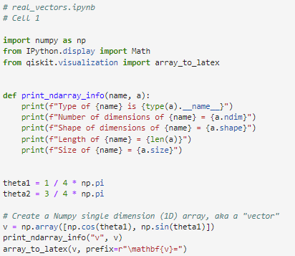

Open real_vectors.ipynb
①
②
③
④
⑤
⑥
⑦
⑤ → You can create a Numpy ndarray from a Python list using np.array()

Slide 15
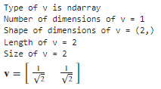
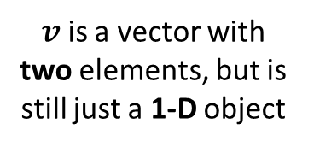
Run Cell 1 – real_vectors.ipynb
$v$ is a vector with two elements, but is still just a 1-D object
Notice the comma with nothing after it
len() only returns the number of items in the
1st dimension of an np.ndarray

Slide 16
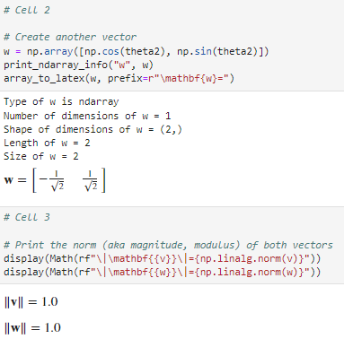
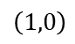
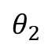
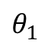
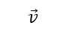
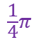
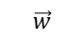
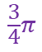
Run Cells 2 & 3 – real_vectors.ipynb
$$\vec{w}$$
$$\vec{v}$$
$$\frac{3}{4}π$$
$$θ_{2}$$
$$θ_{1}$$
$$\frac{1}{4}π$$
$$\left(1,0\right)$$
①

Slide 17
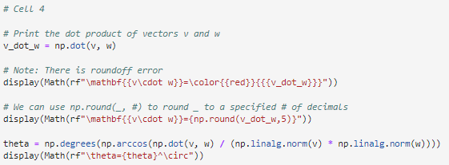
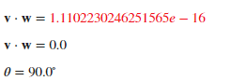
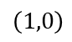
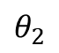
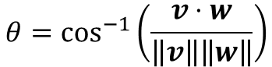
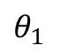




Run Cell 4 – real_vectors.ipynb
①
②
③
④
$$\vec{w}$$
$$\vec{v}$$
$$\frac{3}{4}π$$
$$θ_{2}$$
$$θ_{1}$$
$$\frac{1}{4}π$$
$$\left(1,0\right)$$
$$θ=\cos^{−1}\left(\frac{v⋅w}{\left\|v\right\|\left\|w\right\|}\right)$$

Slide 18


Run Cell 5 – real_vectors.ipynb
①
②
LaTeX Math Symbols - Handy Reference

Slide 19



Run Cell 6 – real_vectors.ipynb
①
①

Slide 20
Symbols and Operators
$c_{n},z_{n}$ = Complex Scalar
$\vec{v}, v$ = Vector (1D array)
$v_{n}$= Vector Components
= Vector Norm
$⋅$ = Dot Product
= Inner Product
$⨂$ = Tensor Product
$A$ = Matrix (2D array)
$A^{−1}$= Inverse
$A^{T}$= Transpose
$A^{†}$= Adjoint
$Tr\left(A\right)$ = Trace
$I$ = Identity Matrix
$H$ = Hadamard Matrix

Slide 21
Matrices
A “matrix” in NumPy is represented as vectors of vectors
A matrix can hold any number of elements (in each dimension), but all elements must be of the same data type, such as int or float
Matrix elements are accessed by their index numbers, which starts at zero and correspond to each dimension
Matrix nomenclature
In mathematics, a matrix size is written as (Rows x Columns)
In NumPy a matrix (aka a ndarray) is written using commas instead of multiplication crosses, and using square brackets instead of parenthesis: [Row,Column]
Example: the NumPy array [5,7] has 5 rows and 7 columns

Slide 22


Types of Matrices
Identity Matrix

Slide 23

Matrix Multiplication
When rendering computer graphics, we often need to find the product of two matrices, e.g.
$$\left(\begin{matrix}4 & 5 & 8 \\ 1 & 9 & 7\end{matrix}\right)⋅\left(\begin{matrix}2 & 4 \\ 6 & 1 \\ 5 & 9\end{matrix}\right)= ?$$
There is a standard algorithm to do this multiplication
It involves multiplying each element in the rows of first matrix by each element in the columns of the second matrix

Slide 24
Matrix Multiplication
In order to multiply two matrices together, the number of columns in matrix A must equal the number of rows in matrix B (Cols A = Rows B)
The resulting matrix will have as many rows as there were rows in matrix A, and as many columns as there were columns in matrix B (Rows A x Cols B)

Slide 25


Matrix Multiplication
Example
Matrix A has dimension (2 x 3) = 2 rows, 3 columns
Matrix B has dimension (3 x 2) = 3 rows, 2 columns
$$\left(\begin{matrix}4 & 5 & 8 \\ 1 & 9 & 7\end{matrix}\right)⋅\left(\begin{matrix}2 & 4 \\ 6 & 1 \\ 5 & 9\end{matrix}\right)= ?$$
The inner values must match!
A
B
(2 x 3) $⋅$ (3 x 2)
A
B
The outer values will be
the dimension of the final
matrix product!

Slide 26

Matrix Multiplication
Matrix multiplication is not commutative!
If we multiple A x B we may get a different matrix than if we multiply B x A
(3 x 2) $⋅$ (2 x 3) = result is a (3 x 3) matrix
(2 x 3) $⋅$ (3 x 2) = result is a (2 x 2) matrix
You might not even be able to multiply in the reverse order
(2 x 3) $⋅$ (3 x 5) = result is a (2 x 5) matrix
(3 x 5) $⋅$ (2 x 3) = Not allowed (5 $≠$ 2)aaa
Welcome to the world of non-commutative algebra
This is very strange – it catches even great physicists by surprise!
This asymmetry is the foundation of the matrix formulation of quantum mechanics

Slide 27

Matrix Multiplication
The algorithm is simple but tedious for A $∙$ B = C
Sum the product of every element in each row of matrix A and the corresponding element in each column of matrix B
That sum becomes just one element in new matrix C
Continue this process for all rows in matrix A
Every row in A gets multiplied by every column in B
The resulting matrix will have dimensions (Rows A x Cols B)

Slide 28

Matrix Multiplication

Slide 29
Matrix Multiplication

Slide 30
Matrix Multiplication

Slide 31
Matrix Multiplication

Slide 32
Matrix Multiplication

Slide 33

Open matrix_algebra.ipynb
①
②
③
④

Slide 34

Run Cell 1 – matrix_algebra.ipynb
①
len() only returns the number of items in the
1st dimension of an np.ndarray
②
③
④
⑤
⑥

Slide 35


Run Cells 2 & 3 – matrix_algebra.ipynb
①
②
See slide #32
③
$$3×2∙2×3=3×3$$

Slide 36


Run Cell 4 – matrix_algebra.ipynb
Operand 0 (b)
Operand 1 (a)
$$3×2∙3×3=Error!$$
Dimension 0
Generalized Universal Function API

Slide 37
Determinant of a Matrix
In linear algebra, the determinant is a value that can be computed from the elements of a square matrix
The determinant can be used:
To solve a system of linear equations when those equations are represented by a matrix
To find the Jacobian of the matrix of all first-order partial derivatives of a vector-valued function
To calculate the characteristic polynomial of a matrix which is essential for eigenvalue problems
To express the signed n-dimensional volumes of n-dimensional parallelepipeds in analytic geometry

Slide 38
Determinant of a Matrix
Calculating the Determinant of a 2 x 2 Matrix
$$A=\left[\begin{matrix}a_{11} & a_{12} \\ a_{21} & a_{22}\end{matrix}\right]→\det{A}=\left|A\right|=\left|\begin{matrix}a_{11} & a_{12} \\ a_{21} & a_{22}\end{matrix}\right|$$
$$det\left[\begin{matrix}a_{11} & a_{12} \\ a_{21} & a_{22}\end{matrix}\right]=a_{11}∙a_{22}−a_{12}∙a_{21}$$
$$det\left[\begin{matrix}a_{11} & a_{12} \\ a_{21} & a_{22}\end{matrix}\right]=a_{11}∙a_{22}−a_{12}∙a_{21}$$

Slide 39
Determinant of a Matrix
Calculating the Determinant of a 2 x 2 Matrix
$$A=\left[\begin{matrix}a_{11} & a_{12} \\ a_{21} & a_{22}\end{matrix}\right]→\det{A}=\left|A\right|=\left|\begin{matrix}a_{11} & a_{12} \\ a_{21} & a_{22}\end{matrix}\right|$$
$$det\left[\begin{matrix}a_{11} & a_{12} \\ a_{21} & a_{22}\end{matrix}\right]=a_{11}∙a_{22}−a_{12}∙a_{21}$$
$$det\left[\begin{matrix}8 & 3 \\ 4 & 2\end{matrix}\right]=8∙2 −3∙4=16−12=4$$

Slide 40
Determinant of a Matrix
Calculating the Determinant of a 3 x 3 Matrix
$$\det{A}=\left|A\right|=\left|\begin{matrix}a_{11} & a_{12} & a_{13} \\ a_{21} & a_{22} & a_{23} \\ a_{31} & a_{32} & a_{33}\end{matrix}\right|$$
$$\left|A\right|=a_{11}\left|\begin{matrix}a_{22} & a_{23} \\ a_{32} & a_{33}\end{matrix}\right|−a_{21}\left|\begin{matrix}a_{12} & a_{13} \\ a_{32} & a_{33}\end{matrix}\right|+a_{31}\left|\begin{matrix}a_{12} & a_{13} \\ a_{22} & a_{23}\end{matrix}\right|$$

Slide 41
Determinant of a Matrix
Calculating the Determinant of a 3 x 3 Matrix
$$\det{A}=\left|A\right|=\left|\begin{matrix}a_{11} & a_{12} & a_{13} \\ a_{21} & a_{22} & a_{23} \\ a_{31} & a_{32} & a_{33}\end{matrix}\right|$$
$$\left|A\right|=a_{11}\left|\begin{matrix}a_{22} & a_{23} \\ a_{32} & a_{33}\end{matrix}\right|−a_{21}\left|\begin{matrix}a_{12} & a_{13} \\ a_{32} & a_{33}\end{matrix}\right|+a_{31}\left|\begin{matrix}a_{12} & a_{13} \\ a_{22} & a_{23}\end{matrix}\right|$$

Slide 42
Determinant of a Matrix
Calculating the Determinant of a 3 x 3 Matrix
$$\det{A}=\left|A\right|=\left|\begin{matrix}a_{11} & a_{12} & a_{13} \\ a_{21} & a_{22} & a_{23} \\ a_{31} & a_{32} & a_{33}\end{matrix}\right|$$
$$\left|A\right|=a_{11}\left|\begin{matrix}a_{22} & a_{23} \\ a_{32} & a_{33}\end{matrix}\right|−a_{21}\left|\begin{matrix}a_{12} & a_{13} \\ a_{32} & a_{33}\end{matrix}\right|+a_{31}\left|\begin{matrix}a_{12} & a_{13} \\ a_{22} & a_{23}\end{matrix}\right|$$

Slide 43
Determinant of a Matrix
Calculating the Determinant of a 3 x 3 Matrix
$$\det{A}=\left|A\right|=\left|\begin{matrix}a_{11} & a_{12} & a_{13} \\ a_{21} & a_{22} & a_{23} \\ a_{31} & a_{32} & a_{33}\end{matrix}\right|$$
$$\left|A\right|=a_{11}\left|\begin{matrix}a_{22} & a_{23} \\ a_{32} & a_{33}\end{matrix}\right|−a_{21}\left|\begin{matrix}a_{12} & a_{13} \\ a_{32} & a_{33}\end{matrix}\right|+a_{31}\left|\begin{matrix}a_{12} & a_{13} \\ a_{22} & a_{23}\end{matrix}\right|$$

Slide 44

Determinant of a Matrix
Calculating the Determinant of a 4 x 4 Matrix
Notice the definition of determinant is inherently recursive:
The determinant of a $n x n$matrix is calculated from the determinants of $n$ reduced matrices of size $(n−1)×(n−1)$,
and so on and so on, getting down to simple 2 x 2 matrices

Slide 45
Determinant of a Matrix
Calculating the Determinant of a 4 x 4 Matrix
These smaller matrices, where a row and column has been removed, are called the cofactors of the original (larger) matrix
Notice the sign in front of each cofactor alternates from positive (+1) to negative (-1)

Slide 46

Run Cell 5 – matrix_algebra.ipynb
①
②
③
①
②
③

Slide 47


Run Cell 6 – matrix_algebra.ipynb
①
②
③
Determinants can get quite large!

Slide 48

Determinant of a Matrix
Always seek independent confirmation!

Slide 49







Matrix Inversion
Non-square matrices are not directly invertible
Matrix Division
Solve System of Linear Equations
$$\frac{A}{B}=A⋅B^{−1}$$
$$A⋅x=B$$
$$A^{−1}⋅\left(A⋅x\right)=A^{−1}⋅B$$
$$\left(A^{−1}⋅A\right)⋅x=A^{−1}⋅B$$
$$I⋅x=A^{−1}⋅B$$
$$x=A^{−1}⋅B$$

Slide 50
Goal: Solve a System of Linear Equations
Two Equations and Two Unknowns
$$ax+by=c$$
$$dx+ey=f$$
$$ax=c−by$$
$$\frac{d(c−by)}{a}+ey=f$$
$$x=\frac{c−by}{a}$$
$$cd−bdy+aey=af$$
$$y\left(ae−bd\right)=af−cd$$
$$y=\frac{af−cd}{ae−bd}$$

Slide 51
Goal: Solve a System of Linear Equations
Two Equations and Two Unknowns
$$ax+by=c$$
$$dx+ey=f$$
$$by=c−ax$$
$$dx+\frac{e(c−ax)}{b}=f$$
$$y=\frac{c−ax}{b}$$
$$bdx+ce−aex=bf$$
$$x\left(bd−ae\right)=bf−ce$$
$$x=\frac{bf−ce}{bd−ae}\left(\frac{−1}{−1}\right)=\frac{ce−bf}{ae−bd}$$

Slide 52
Goal: Solve a System of Linear Equations
Two Equations and Two Unknowns
$$ax+by=c$$
$$dx+ey=f$$
$$x=\frac{ce−bf}{ae−bd}$$
$$y=\frac{af−cd}{ae−bd}$$
$$\det{C=\left|\begin{matrix}a & b \\ d & e\end{matrix}\right|=ae−bd}$$

Slide 53
Goal: Solve a System of Linear Equations
Two Equations and Two Unknowns
$$ax+by=c$$
$$dx+ey=f$$
$$\det{A=\left|\begin{matrix}c & b \\ f & e\end{matrix}\right|=ce−bf}$$
$$x=\frac{ce−bf}{ae−bd}$$
$$y=\frac{af−cd}{ae−bd}$$
$$\det{C=\left|\begin{matrix}a & b \\ d & e\end{matrix}\right|=ae−bd}$$

Slide 54
Goal: Solve a System of Linear Equations
Two Equations and Two Unknowns
$$ax+by=c$$
$$dx+ey=f$$
$$\det{A=\left|\begin{matrix}c & b \\ f & e\end{matrix}\right|=ce−bf}$$
$$x=\frac{ce−bf}{ae−bd}$$
$$\det{B=\left|\begin{matrix}a & c \\ d & f\end{matrix}\right|=af−cd}$$
$$y=\frac{af−cd}{ae−bd}$$
$$\det{C=\left|\begin{matrix}a & b \\ d & e\end{matrix}\right|=ae−bd}$$

Slide 55
Goal: Solve a System of Linear Equations
Two Equations and Two Unknowns
$$ax+by=c$$
$$dx+ey=f$$
$$\det{A=\left|\begin{matrix}c & b \\ f & e\end{matrix}\right|=ce−bf}$$
$$x=\frac{ce−bf}{ae−bd}$$
$$x=\frac{\left|A\right|}{\left|C\right|}$$
$$\det{B=\left|\begin{matrix}a & c \\ d & f\end{matrix}\right|=af−cd}$$
$$y=\frac{af−cd}{ae−bd}$$
$$y=\frac{\left|B\right|}{\left|C\right|}$$
$$\det{C=\left|\begin{matrix}a & b \\ d & e\end{matrix}\right|=ae−bd}$$

Slide 56

Goal: Solve a System of Linear Equations
Three Equations and Three Unknowns

Slide 57

Cramer’s Rule
We create one overlay matrix for each unknown

Slide 58

Run Cell 7 – matrix_algebra.ipynb
①
②
①
②

Slide 59


Run Cell 8 – matrix_algebra.ipynb
①
②
③
④
⑤
⑥
⑦
⑧

Slide 60

Run Cell 9 – matrix_algebra.ipynb
①
②

Slide 61




Matrix Transpose (T)
Interchange Rows for Columns
$$\left[\begin{matrix}v_{0} \\ v_{1} \\ v_{2} \\ v_{3}\end{matrix}\right]={\left[v_{0},v_{1}{,v}_{2},v_{3}\right]}^{T}$$
To save print space, authors often write a vector as a row matrix followed by the T operator
A vector can be written as a column matrix…
…or as a row matrix
$$(1, 4)$$
$$(4, 1)$$

Slide 62




Matrix Adjoint (H) and Trace
Aka "Dagger" →
$$A^{†}={\left(\overline{A}\right)}^{T}=\overline{A^{T}}=A^{H}$$
← Hermitian adjoint
$$Tr\left[\begin{matrix}a & b & c \\ d & e & f \\ g & h & i\end{matrix}\right]=a+e+i$$
The "Trace" →
Note: Only square matrices have a trace!

Slide 63




Hermitian Matrix
All Hermitian matrices are square and equal to their own conjugate transpose
A matrix is Hermitian if
Charles Hermite
(1822-1901)
$$A^{†}=A$$
Note: H may also refer to a Hadamard Matrix

Slide 64







Complex Vector Algebra
$$v+w=\left(v+w\right)$$
Vector Addition
$$\left(−v\right)=−\left(v\right)$$
Additive Inverse
$$c⋅v=\left(c∙v\right)$$
Scalar Multiplication
Scalar doesn't mean only $∈ℝ$

Slide 65








Complex Scalar Multiplication
$$v=v_{1}\hat{i}+v_{2}\hat{j}+v_{3}\hat{k}$$
$$v_{1},v_{2},v_{3}∈ℝ or ℂ$$
$$\left\|v\right\|=\sqrt{{\left|v_{1}\right|}^{2}+{\left|v_{2}\right|}^{2}+{\left|v_{3}\right|}^{2}}$$
Unit basis vectors have length = 1
$$z∈ℂ$$
$$\left|z\right|⋅\left\|v\right\|=\left|z\right|\sqrt{{\left|v_{1}\right|}^{2}+{\left|v_{2}\right|}^{2}+{\left|v_{3}\right|}^{2}}$$
$$\left\|\left|z\right|⋅v\right\|=\sqrt{{\left(\left|z\right|{⋅v}_{1}\hat{i}\right)}^{2}+{\left(\left|z\right|⋅v_{2}\hat{j}\right)}^{2}+{\left(\left|z\right|⋅v_{3}\hat{k}\right)}^{2}}$$
Scalar Multiplication respects Norms
$$= \sqrt{{\left|z\right|}^{2}\left({\left|v_{1}\right|}^{2}+{\left|v_{2}\right|}^{2}+{\left|v_{3}\right|}^{2}\right)}$$
$$=\left|z\right|\sqrt{{\left|v_{1}\right|}^{2}+{\left|v_{2}\right|}^{2}+{\left|v_{3}\right|}^{2}}$$
$$=\left|z\right|∙\left\|v\right\|$$

Slide 66










Complex Inner Product
Column Matrix
Column Matrix
numpy.vdot() and Qiskit
$$v=\left[\begin{matrix}7−2i \\ 4i \\ 11+6i \\ −15\end{matrix}\right]$$
$$w=\left[\begin{matrix}−3−5i \\ 2+9i \\ −12i \\ 1+8i\end{matrix}\right]$$
$$\left\langle v,w\right\rangle =v^{†}⋅w=\left\langle v\left|w\right.\right\rangle$$
$$v^{†}$$
$$w$$
$$\left[\begin{matrix}7+2i & −4i & 11−6i & −15\end{matrix}\right]⋅\left[\begin{matrix}−3−5i \\ 2+9i \\ −12i \\ 1+8i\end{matrix}\right]=\begin{matrix}\left(7+2i\right)\left(−3−5i\right) \\ (0−4i)(2+9i) \\ (11−6i)(0−12i) \\ (−15+0i)(1+8i)\end{matrix}=+ \begin{matrix}\begin{aligned}−11−41i \\ 36−8i\end{aligned} \\ \begin{aligned}−72−132i \\ −15−120i\end{aligned}\end{matrix}$$
(1 x 4) • (4 x 1) = (1 x 1) $→$ Scalar
$$\left\langle v,w\right\rangle =−62−301i$$
The complex inner product of
two vectors uses the
dot product to produce a scalar
but needs the adjoint of the first vector
Inner Product of Square Matrices
$$\left\langle A,B\right\rangle =Tr\left(A^{†}⋅B\right)$$
If $A$ and $B$ have same dimensions

Slide 67








Complex Vector Norm
$$v=\left[\begin{matrix}7−2i \\ 4i \\ 11+6i \\ −15\end{matrix}\right]$$
$$\left\|v\right\|=\sqrt{\left\langle v,v\right\rangle }=\sqrt{v^{†}⋅v}=\sqrt{{\left(\overline{v}\right)}^{T}⋅v}$$
The "norm" of a vector of complex numbers must be a positive real scalar
because length cannot be negative or imaginary
$$\left[\begin{matrix}7+2i & −4i & 11−6i & 15\end{matrix}\right]⋅\left[\begin{matrix}7−2i \\ 4i \\ 11+6i \\ 15\end{matrix}\right]=\left[\begin{matrix}\left(7+2i\right)\left(7−2i\right) \\ \left(−4i\right)\left(4i\right) \\ \left(11−6i\right)\left(11+6i\right) \\ \left(15\right)\left(15\right)\end{matrix}\right]=\left[\begin{matrix}53 \\ 16 \\ 157 \\ 225\end{matrix}\right]=451$$
$$v^{†}$$
$$v$$
$$\left\|v\right\|=\left[\begin{matrix}7+2i & −4i & 11−6i & −15\end{matrix}\right]⋅\left[\begin{matrix}7−2i \\ 4i \\ 11+6i \\ 15\end{matrix}\right]=\sqrt{451}=21.23676…$$
$$v^{†}$$
$$v$$
$$=\sqrt{v^{†}⋅v}=\sqrt{\left\langle v,v\right\rangle }$$

Slide 68






Unitary Matrices
$$U=\left[\begin{matrix}\frac{1}{\sqrt{2}} & 0 & \frac{1}{\sqrt{2}} & 0 \\ 0 & \frac{1}{\sqrt{2}} & 0 & \frac{1}{\sqrt{2}} \\ \frac{1}{\sqrt{2}} & 0 & −\frac{1}{\sqrt{2}} & 0 \\ 0 & \frac{1}{\sqrt{2}} & 0 & −\frac{1}{\sqrt{2}}\end{matrix}\right]$$
$$U=\left[\begin{matrix}\cos{θ} & \sin{θ} & 0 \\ −sin{θ} & \cos{θ} & 0 \\ 0 & 0 & 1\end{matrix}\right]$$
Clockwise Rotation Matrix
$$U^{†}=\left[\begin{matrix}\cos{θ} & −\sin{θ} & 0 \\ \sin{θ} & \cos{θ} & 0 \\ 0 & 0 & 1\end{matrix}\right]$$
Counterclockwise Rotation Matrix
A Unitary Matrix Respects Norms
$$U⋅U^{†}=U^{†}⋅U=I$$
$$\left\|U⋅v\right\|=\sqrt{\left\langle U⋅v,U⋅v\right\rangle }=\left\|v\right\|$$
Unitary matrices are invertible, their inverse is their adjoint, and they preserve norms
A unitary matrix "preserves the geometry" (lengths & relative angles) of the space is acts upon
$U^{†}$ can "undo" $U$
Reversible Computations

Slide 69

Complex Vector & Matrix Identities
$\left\langle v,v\right\rangle ={\left\|v\right\|}^{2}$
The inner product of a vector with itself is its squared norm
$\left\langle v,v\right\rangle =\overline{\left\langle v,v\right\rangle }$
An inner product is equal to its own conjugate
${\left(A+B\right)}^{†}=A^{†}+B^{†}$
The adjoint (dagger) operator is distributive across matrix addition
$\left\langle v,w\right\rangle =Tr\left(v^{†}⋅w\right)$
The inner product of two equal length vectors is equal to the trace of their dot product
$Tr\left[xA+yB\right]=xTr\left[A\right]+yTr\left[B\right]$
The trace operator is distributive across scalar-array multiplication

Slide 70



Open complex_matrices.ipynb
t1
t2
$$\left\langle v,v\right\rangle ={\left\|v\right\|}^{2}$$
①
②
Transposing a vector (which is inherently one-dimensional) really does nothing
③

Slide 71

Run Cell 1 – complex_matrices.ipynb
$$\left\langle v,v\right\rangle ={\left\|v\right\|}^{2}$$
Transposing a vector (which is inherently one-dimensional) really does nothing

Slide 72



Run Cell 2 – complex_matrices.ipynb
t1
t2
$$\left\langle v,v\right\rangle =\overline{\left\langle v,v\right\rangle }$$
①
①
②
②
What are the differences between $...$ and $$...$$ ???

Slide 73



Run Cell 3 – complex_matrices.ipynb
t1
t2
$${\left(A+B\right)}^{†}=A^{†}+B^{†}$$
Now we do need to use .T because we are dealing with 2D arrays (matrices)
There is no simple equality test for numpy matrices so
we must use the .all() method after .isclose()

Slide 74




Run Cell 4 – complex_matrices.ipynb
t1
t2
$$\left\langle v,w\right\rangle =Tr\left(v^{†}⋅w\right)$$
$$\left(4×1\right)⋅\left(1×4\right)=\left(4×4\right)$$
①

Slide 75



Run Cell 5 – complex_matrices.ipynb
t1
t2
$$Tr\left[xA+yB\right]=xTr\left[A\right]+yTr\left[B\right]$$
①
②
②

Slide 76

Complex Vector & Matrix Identities
$\left\langle A⋅v,w\right\rangle =\left\langle v,A⋅w\right\rangle$if and only if $A hermitian$
Within an inner product, a Hermitian matrix can be dotted to either vector
$\left\|v\right\|=\left\|U⋅v\right\|=\sqrt{\left\langle U⋅v,U∙v\right\rangle } if U unitary$
The dot product of a Unitary matrix with a vector respects the norm
$\left\langle v,w\right\rangle =\overline{\left\langle w,v\right\rangle }$
Commutation of two vectors within an inner product produces the conjugate of that inner product
$\left|\left\langle v,w\right\rangle \right|≤\left\|v\right\|\left\|w\right\|$
Demonstrate the Cauchy–Schwarz inequality
${\left(A⋅B\right)}^{†}=B^{†}⋅A^{†}$
The adjoint operator is distributive across a commutated dot product

Slide 77




Run Cell 6 – complex_matrices.ipynb
t1
t2
$$\left\langle A⋅v,w\right\rangle =\left\langle v,A⋅w\right\rangle iff A hermitian$$
①
Matrix $A$ is Hermitian
$$A=A^{†}$$

Slide 78


Run Cell 7 – complex_matrices.ipynb
t1
t2
$$\left\|v\right\|=\left\|U⋅v\right\|=\sqrt{\left\langle U⋅v,U∙v\right\rangle } if U unitary$$
①
①
②
③
②
④
④

Slide 79



Run Cell 8 – complex_matrices.ipynb
t1
t2
$$\left\langle v,w\right\rangle =\overline{\left\langle w,v\right\rangle }$$
①
①
②
②

Slide 80





Run Cell 9 – complex_matrices.ipynb
t1
t2
$$\left|\left\langle v,w\right\rangle \right|≤\left\|v\right\|\left\|w\right\|$$
①
②

Slide 81



Run Cell 10 – complex_matrices.ipynb
t1
t2
$${\left(A⋅B\right)}^{†}=B^{†}⋅A^{†}$$
①
Now we do need to use .T because we are dealing with 2D arrays (matrices)
②

Slide 82



Run Cell 11 – complex_matrices.ipynb
$\left\|c⋅v\right\|=\left|c\right|∙\left\|v\right\|$
Complex scalar multiplication respects a vector's norm
①
②

Slide 83




Basis Sets
$$v=c_{0}⋅v_{0}+c_{1}⋅v_{1}+c_{2}⋅v_{2}+c_{n−1}⋅v_{n−1}$$
The set of linearly independent vectors $\left\{v_{0},v_{1},v_{2},v_{n−1}\right\}$ is called the basis set for $v$
$v_{0}=\left[\begin{matrix}1 \\ 0 \\ ⋮ \\ 0\end{matrix}\right],v_{1}=\left[\begin{matrix}0 \\ 1 \\ ⋮ \\ 0\end{matrix}\right],v_{2}=\left[\begin{matrix}0 \\ ⋮ \\ 1 \\ 0\end{matrix}\right],$ $v_{n−1}=\left[\begin{matrix}0 \\ 0 \\ ⋮ \\ 1\end{matrix}\right]$
This is the canonical basis set for $C^{n}$
Basis vectors can have elements of any value (not just 1)
but must all remain linearly independent
$$v=\sum_{j=0}^{n−1}{\left(c_{j}⋅v_{j}\right)}$$
Every vector is a linear sum of amplitudes and its basis vectors

Slide 84






Basis Sets
Orthogonal Basis
$$\left(\vec{u},\vec{v},\vec{w}\right)$$
All perpendicular, but $\left|\left(\vec{u},\vec{v},\vec{w}\right)\right| ≠ 1$
Orthonormal Basis
$$\left(\hat{i},\hat{j},\hat{k}\right)$$
All perpendicular, and $\left|\left(\hat{i},\hat{j},\hat{k}\right)\right|= 1$

Slide 85










Change of Basis (Transition Matrix)
$$𝕭=\left\{\left[\begin{matrix}1 \\ −3\end{matrix}\right],\left[\begin{matrix}−2 \\ 4\end{matrix}\right]\right\}$$
$$𝕯=\left\{\left[\begin{matrix}−7 \\ 9\end{matrix}\right],\left[\begin{matrix}−5 \\ 7\end{matrix}\right]\right\}$$
$$v=\left[\begin{matrix}7 \\ −17\end{matrix}\right]=3\left[\begin{matrix}1 \\ −3\end{matrix}\right]−2\left[\begin{matrix}−2 \\ 4\end{matrix}\right]$$
$$v_{𝕯}=M_{𝕯←𝕭}⋅v_{𝕭}$$
$$M_{𝕯←𝕭}=\left[\begin{matrix}2 & \frac{−3}{2} \\ −3 & \frac{5}{2}\end{matrix}\right]$$
$$v_{𝕭}=\left[\begin{matrix}3 \\ −2\end{matrix}\right]$$
A Transition Matrix
$$v_{𝕯}=M_{𝕯←𝕭}⋅v_{𝕭}=\left[\begin{matrix}2 & \frac{−3}{2} \\ −3 & \frac{5}{2}\end{matrix}\right]\left[\begin{matrix}3 \\ −2\end{matrix}\right]=\left[\begin{matrix}9 \\ −14\end{matrix}\right]$$
$$\left(2×2\right)⋅\left(2×1\right)=\left(2×1\right)$$
The original vector $v$ does not change, only the components of $v$ change per each basis set
$$v=\left[\begin{matrix}7 \\ −17\end{matrix}\right]=9\left[\begin{matrix}−7 \\ 9\end{matrix}\right]−14\left[\begin{matrix}−5 \\ 7\end{matrix}\right]$$

Slide 86







Change of Basis (Transition Matrix)
$$𝕯=\left\{\left[\begin{matrix}\frac{1}{\sqrt{2}} \\ \frac{1}{\sqrt{2}}\end{matrix}\right],\left[\begin{matrix}\frac{1}{\sqrt{2}} \\ −\frac{1}{\sqrt{2}}\end{matrix}\right]\right\}$$
$$𝕭=\left\{\left[\begin{matrix}1 \\ 0\end{matrix}\right],\left[\begin{matrix}0 \\ 1\end{matrix}\right]\right\}$$
Canonical basis set in $ℝ^{2}$
(Cartesian Coordinates)
$$V_{𝕯}=M_{𝕯←𝕭}⋅V_{𝕭}$$
Jacques Hadamard
(1865-1963)
$$M_{𝕯←𝕭}=\frac{1}{\sqrt{2}}\left[\begin{matrix}1 & 1 \\ 1 & −1\end{matrix}\right]=H$$
Hadamard Matrix
Applying the Hadamard Matrix twice undoes the basis change…
$${\left(\frac{1}{\sqrt{2}}\left[\begin{matrix}1 & 1 \\ 1 & −1\end{matrix}\right]\right)}^{2}=\frac{1}{2}\left[\begin{matrix}2 & 0 \\ 0 & 2\end{matrix}\right]=I$$
…because the Hadamard Matrix is a Unitary Matrix

Slide 87



Eigenvectors and Eigenvalues
A matrix (an operator) acts (via the dot product) on a vector
If the dot product of a matrix and a vector yields a scalar multiple of that vector, then that vector is called an eigenvector of the matrix, and that scalar multiple is called an eigenvalue
An operator (matrix) owns its eigenvectors and eigenvalues
("eigen" is German for possession)
$$A⋅v=λ⋅v$$
$$\left[\begin{matrix}4 & −1 \\ 2 & 1\end{matrix}\right]\left[\begin{matrix}1 \\ 2\end{matrix}\right]=2\left[\begin{matrix}1 \\ 2\end{matrix}\right]$$
The solutions to the characteristic polynomial of a square matrix are its eigenvalues
All square $n×n$ matrices have exactly$n$ complex eigenvalues with multiplicity
(Fundamental Theorem of Algebra)

Slide 88


Open eigenvalues.ipynb
①
②

Slide 89


Run Cell 1 – eigenvalues.ipynb
$$B=B^{†}$$

Slide 90



Run Cell 2 – eigenvalues.ipynb
t1
t2
$$A⋅v=λ⋅v$$
①
②
③
②
③
Using .all() allow us to verify the equality across all three components of the 2nd eigenvector
④

Slide 91



Run Cell 3 – eigenvalues.ipynb
①
The only possible measurements that can be made in quantum mechanics are the eigenvalues of Hermitian operators (matrices) which conveniently are
all real numbers ☺
$$B=B^{†}$$
$B$ is Hermitian

Slide 92





Run Cell 4 – eigenvalues.ipynb
$$B=B^{†}$$
$B$ is Hermitian
①
②
③
A quantum state, when measured, collapses to one of the eigenvectors of its Hermitian operator (matrix).
Hence these eigenvectors must be orthogonal to be mutually exclusive and consistently measurable.

Slide 93
Session 14 – Now You Know...
Complex number multiplication is rotation (phase addition)
Orthogonal vectors have a zero inner product
The complex inner product requires using the conjugate transpose (aka dagger, adjoint or Hermitian) of the first vector because the norm of a complex vector must be real
Matrix multiplication is non-commutative
Unitary matrices are fundamental in quantum computing because applying it twice can undo its action
A Hermitian matrix has orthogonal eigenvectors and real eigenvalues and represent the only possible measurements that can be made of a quantum system

Slide 94
Session 14A – Goals
Create a 2D maze on graph paper
Understand how to encode the cell walls in base 2
Learn how bitwise operators can decode a wall value
Perform file input / output using CSV and binary formats
Appreciate backtracking in depth-first search algorithm
Implement breadcrumbs using a stack data structure
Understand how an adjacency matrix can improve depth-first search efficiency

Slide 95
Maze Solver
Write a program that will find a path from the entrance to the exit of a given maze
The maze should be created using a simple encoding
During the search, the program cannot receive any hints from humans – it must run autonomously
The maze is 10x10 cells, and must have at least one open path from entrance to exit cell
The complete maze perimeter must not have any holes – all outside edges must be walls

Slide 96

0
1
2
3
4
5
6
7
8
9
0
10 Rows
10 Cols
Y = Rows
X = Cols
Positive Y is down!
Entrance = [0][0]
Exit
= [9][9]
1
2
This is a just a sample.
You will design and encode your own maze!
3
4
5
6
7
8
9

Slide 97
How do we encode a maze?
Encode each wall position as an increasing power of 2
Consider how to describe each individual square (cell) within the maze
How can we indicate for each individual cell if a wall exists to the North, East, South, or West direction?
North = 1
West = 8
East = 2
South = 4

Slide 98
How do we encode a maze?
If a wall exists in a direction, add the value of that direction to the total cell value
North = 1
9
West = 8
East = 2
South = 4

Slide 99
How do we encode a maze?
Using a power of 2 for each wall value produces an unambiguous encoding of all wall permutations
0 ≤ cell value ≤ 15
No walls = zero (0)
15 = a totally “walled-in” cell that is unreachable (Hint: don’t make a cell = 15)
North = 1
7
West = 8
East = 2
South = 4

Slide 100

0
1
2
3
4
5
6
7
8
9
0
9
5
5
5
7
9
5
5
3
11
1
12
5
5
5
3
12
5
5
0
2
2
9
5
5
5
4
5
7
9
6
14
3
8
5
1
7
9
5
5
4
5
3
4
10
11
12
7
8
5
5
5
7
10
5
10
8
3
9
0
5
5
5
3
10
6
8
6
12
6
12
5
5
5
2
14
7
12
5
1
3
9
5
5
5
6
11
8
13
5
6
10
10
9
3
9
1
2
9
13
5
5
4
4
6
12
6
14
14

Slide 101
Drawing the 2D Maze
Given a maze initialized with Base 2 wall encodings, how can we draw it?
We could use a long series of if() statements to test all 16 possible values for a cell, and draw the required walls
However, this would be inefficient in code size and run time
We can take advantage of bitwise AND to figure out what walls to draw for a given cell

Slide 102
Bitwise Operators
Bitwise operators use single ampersand or pipe character
Bitwise X and Y values: X & Y
Bitwise X or Y values: X | Y
Logical operators only return true or false
Bitwise operators return an integer value
You normally only perform bitwise operations with int types

Slide 103


Bitwise AND
11

Slide 104

Draw and Encode Your Own Maze
Blank Maze Template.pdf
10 Rows
10 Cols
Y = Rows
X = Cols
Positive Y is down!
Entrance = [0][0]
Exit
= [9][9]

Slide 105


Create Your Own maze.csv
10 Rows
10 Cols
Y = Rows
X = Cols
Positive Y is down!
Entrance = [0][0]
Exit
= [9][9]

Slide 106

Run maze_draw.py
②
①
③

Slide 107

If Your maze.csv is Valid…

Slide 108




If Your maze.csv is Not Valid…
Error in Transcribing Encoded Cell Value

Slide 109

Open maze_draw.py
①
②
③
④
⑤
⑥
⑦
⑧
⑨
⑩

Slide 110

View maze_draw.py
⑤
⑥
⑦
⑧
⑨
⑩
①
②
③
④

Slide 111



View maze_draw.py
①
②
③
④
⑤
⑥
numpy genfromtxt()
⑦

Slide 112
Run maze_draw.py
☺

Slide 113
Depth-First Search
Depth-first is a sequential search algorithm
It is just you alone in the maze, you have no helpers
It is a zero-prior knowledge, recursive, backtracking approach
You have breadcrumbs to mark your cell visitation history
Order of step search in each cell is North, East, South, West
We can only proceed in a direction if there is no wall in the path:
if (cell value & direction) != direction
North (1) → (Δ row = -1, Δ column = 0)
East (2) → (Δ row = 0, Δ column = 1)
South (4) → (Δ row = 1, Δ column = 0)
West (8) → (Δ row = 0, Δ column = -1)

Slide 114
Depth-First Search Algorithm
Drop a breadcrumb (Post-it Note) as you enter each cell
Take a step in the very first direction that is open, and go to step #1
If there are no more open directions in the cell, retrace your steps backwards until you reach a cell with a breadcrumb (Post-it Note) where the next open direction is one you have not taken yet
Write the new direction on the Post-it Note, take a step in that new direction, and go to step #1
Stop with you reach the exit square

Slide 115
Depth-First Search Breadcrumbs
A breadcrumb matrix (array) could contain a simple bool value to indicate if you have previously visited this cell
Breadcrumbs prevent going around in endless circles and never finding the exit
But in this program, we maintain a list of tuples called steps where each tuple equals (y, x, last direction tried) for each step along the current path – this is how we track the latest Post-it Note value in each cell
Lots of backtracking in the path indicates an inefficient search pattern, because you are visiting the same node too many times!

Slide 116

Open maze_search.py
①
②
③
④
⑤
⑥
⑦
⑧
⑨
⑩

Slide 117

Depth First Search Breadcrumbs
Entrance
pop()
pop()
We use a “stack” data structure to record the [row][col] of the navigator at each step through the maze

Slide 118



View maze_search.py
①
②
③
④
⑤
⑥
⑦
⑧
⑨
⑩
①
②
③
④
⑤
⑥

Slide 119


View maze_search.py
①
②
③
④
⑤
⑥
⑧
⑨
⑦
⑩

Slide 120

Run maze_search.py

Slide 121
Improving Depth-First Search Efficiency
The unaided depth-first search spends considerable time exploring paths which clearly are not on the optimal route – it hits a lot of dead ends
What if we could calculate the shortest path length, and start backtracking the instant our current path length ≥ the shortest path length?
It is possible to calculate the minimum number of steps from entrance to exit (the shortest path) without searching one cell or taking one step!

Slide 122

Adjacency Matrix
3 x 3 maze
9 total cells

Slide 123

Adjacency Matrix
Every maze square (cell) is represented along both
the rows and columns of an adjacency matrix
A true (1) indicates you can reach the other cell in just one step
A false (0) means that you cannot reach the other cell in just one step

Slide 124
Adjacency Matrix
The main diagonal has all one values
because every cell can reach itself by definition
The whole matrix is symmetric about the main diagonal
because there are no “one-way” doors in the maze.
Reflexive Property: If you can get from cell A to cell B in one step,
then you can also get from cell B to cell A in one step

Slide 125
Adjacency Matrix
To find the shortest path, we keep ANDing (using the logical operator) the adjacency matrix against itself until a True value appears in the matrix element that represents the exit cell
The number of times we had to “multiply” (AND) the adjacency matrix by itself equals the minimal # of steps from entrance to exit
Ironically, we can know the # of steps in the shortest path, but not what the actual steps are!
But how do we "logically" multiple two matrices together?

Slide 126
Adjacency Matrix
If it is True you can get from A to B, and it is True you can get from B to C, then it must be True that you can get from A to C (transitive property)
When “multiplying” Boolean adjacency matrices, if the AND of all the elements in (Row A x Col B) is == True then the cell is set to True
We keep multiplying the adjacency matrix until a True appears in the cell that represents the exit square.
The total # of matrix multiplications required = the shortest path length from entrance to exit

Slide 127
Adjacency Matrix
We can calculate the adjacency matrix before starting a depth-first search
We can then use this shortest path length to limit the current search path to improve the efficiency of the search
Once the current len(steps) has more items than the shortest path length calculated from the adjacency matrix, we must start backtracking!
There is no reason to continue a path which has a step count greater than the known shortest path – it’s best to backup and try a new direction

Slide 128


Adjacency Matrix
Maze Search w/o Adj Matrix
Maze Search with Adj Matrix
On average using an adjacency matrix reduces the steps in a depth-first search by 40% !
Path Steps = 42
Path Steps = 30

Slide 129
Session 14A – Now You Know…
How to encode 2D maze walls in base 2
In Python a [Y][X] matrix means there are Y rows and X columns
The bitwise AND (&) operator can decode wall values
Depth-first search is implemented with recursion or a stack
You must use a breadcrumbs array to prevent infinite loops
A logical adjacency matrix can be used to calculate the length of the shortest path from entrance to exit
However, the adjacency matrix will not identify the actual steps along that shortest path
Leveraging the adjacency matrix during a depth-first search will yield on average a ~40% improvement in the efficiency of the search

Slide 130




Task 14-01
Create a Jupyter Lab notebook called solve4x4.ipynb to solve the following system of linear equations:
Email your working Python program to your TA
$$x_{1}+2x_{2}+x_{3}−x_{4}=5$$
$${3x}_{1}+2x_{2}+4x_{3}+4x_{4}=16$$
$$4x_{1}+4x_{2}+3x_{3}+4x_{4}=22$$
$$2x_{1}+x_{3}+5x_{4}=15$$

Slide 131
Task 14-02
Create a Jupyter Lab notebook called hermitian_matrices.ipynb that demonstrates two matrix identities
Cell 1 - The inverse of a Hermitian matrix is also Hermitian
Cell 2 - A Hermitian matrix raised to an integer exponent yields another Hermitian matrix
Email your working Jupyter Lab notebook to your TA

Slide 132
Task 14-03
Create a 2D maze and then do what you can to "complicate" it, meaning edit key cells in your matrix so the solver must take the greatest number of steps to navigate from the start cell to the exit cell
What makes a maze complex? It is a careful balancing act:
Long straight alleys require backtracking but limits choices and may make navigation easier
Wide open junctions (no cell walls) may require the solver to try more directions, but it may also be easier to navigate straight through to the exit
Does the complexity depend upon the search strategy?
Bonus points for the person who creates the hardest maze!
Email your optimized maze.csv.pickle file to your TA

